Slide 1
Training Tools Utilizing Jupyter Notebooks
Training, Sharing Code, and Testing Techniques and Methods
Notes:
Today I want to share with you my journey using Jupyter Notebooks as a tool for training in a business setting

Slide 2
Joan Pharr
Lead Business Analyst at Valassis Digital
Business Analytics SME for Training
Notes:
My name is Joan Pharr and I’m a Lead Business Analyst with Valassis Digital, a digital marketing company in the Triangle. We run digital advertising campaigns and my team, Business Analytics, is responsible for optimizing these campaigns. To do this we need to access data (lots of data!), run analysis and visualize that data. Quickly, efficiently and transparently. Jupyter Notebooks have been an invaluable tool for our team to achieve these goals. We bridge the gap between current and future product offerings; granting client’s wishes by providing technical expertise to our internal counterparts in Account Management.

Slide 3
Training Program Goals
Onboard new employees into current processes
Train current employees in new features or developments
Space for documentation, notes, outlines
Easy to implement, modify, and maintain
Notes:
I’m also the SME for Training on our team. I want to share some stories and example of how beneficial incorporating Jupyter Notebooks into our workflow and training has been for our team.
We built our training using Jupyter notebooks, which our team already works in.

Slide 4
Starting with Code
CODE
One Time Use
User’s code, testing ground
Infrequently Use
Shared Repo
Frequent Use
Functions & Packages
Notes:
Break into more slides!!!
Who in here uses Python? Great! When our team moved into coding in Python in Jupyter Notebooks we knew it would change our workflow and were excited about the opportunities and efficiencies it could create. But what to do with all the code we generated? How to share and organize that knowledge?
We can bucket/group/categorize this code into three groups depending on explicit usage.

Slide 5
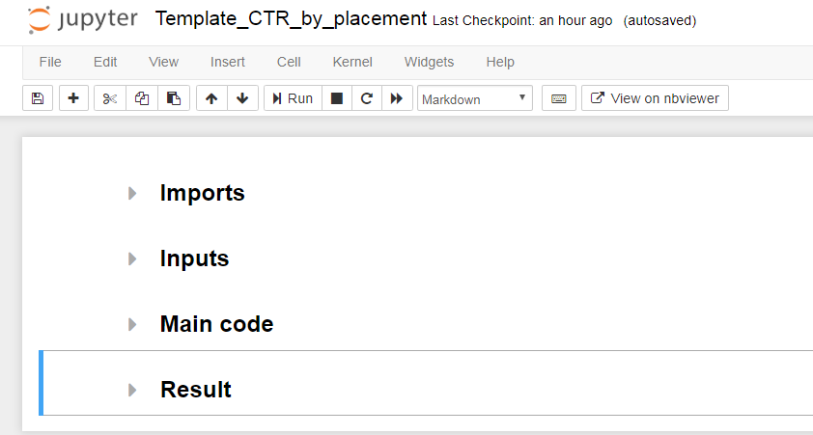
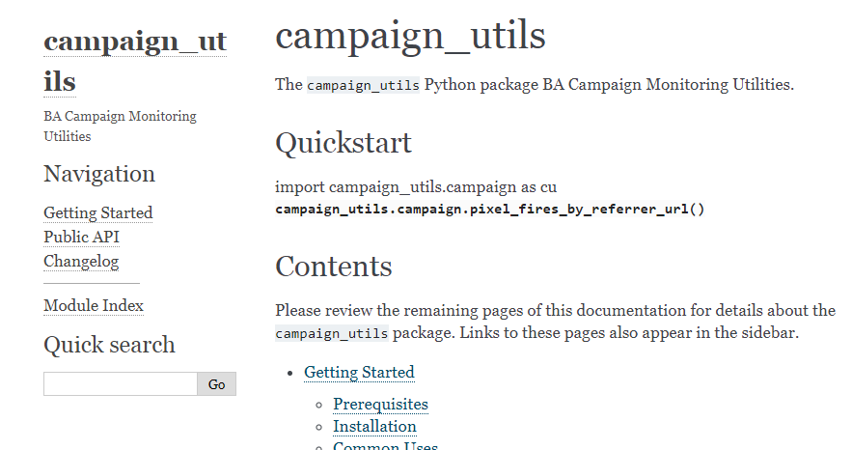
Frequent Use
Formalize into functions and packages
Use to build templates
Notes:
Frequently used code is formalized into functions and encapsulated into packages that are deployed into our local environment. These can then be used across teams as needed.

Slide 6
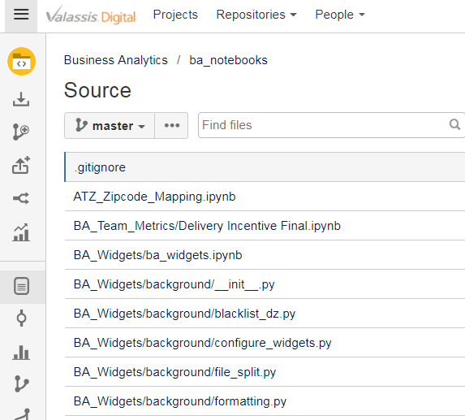
Infrequent Use
Share notebooks via a repository
Notes:
Infrequently used code was an interesting in-between case

Slide 7
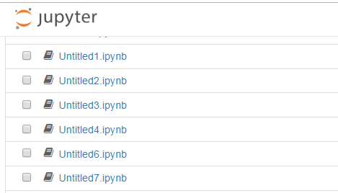
One Time Use
Testing ground
Notes:
One time use, can be saved or deleted as the user determines. Great for testing new methods or packages and developing new code. JOKE

Slide 8
Framework for Implementation
Build training from current workflow
Create Notebook templates to showcase use of packages and functions
House common and infrequent Notebooks in git repo
Notes:
Better Transition here

Slide 9
Templates

Slide 10
Using Notebooks as Templates
Personal workflow
Onboarding new employees
Hands-on learning
Notes:
Document code that you don’t have control over
Templates are a great way to jump right in!

Slide 11
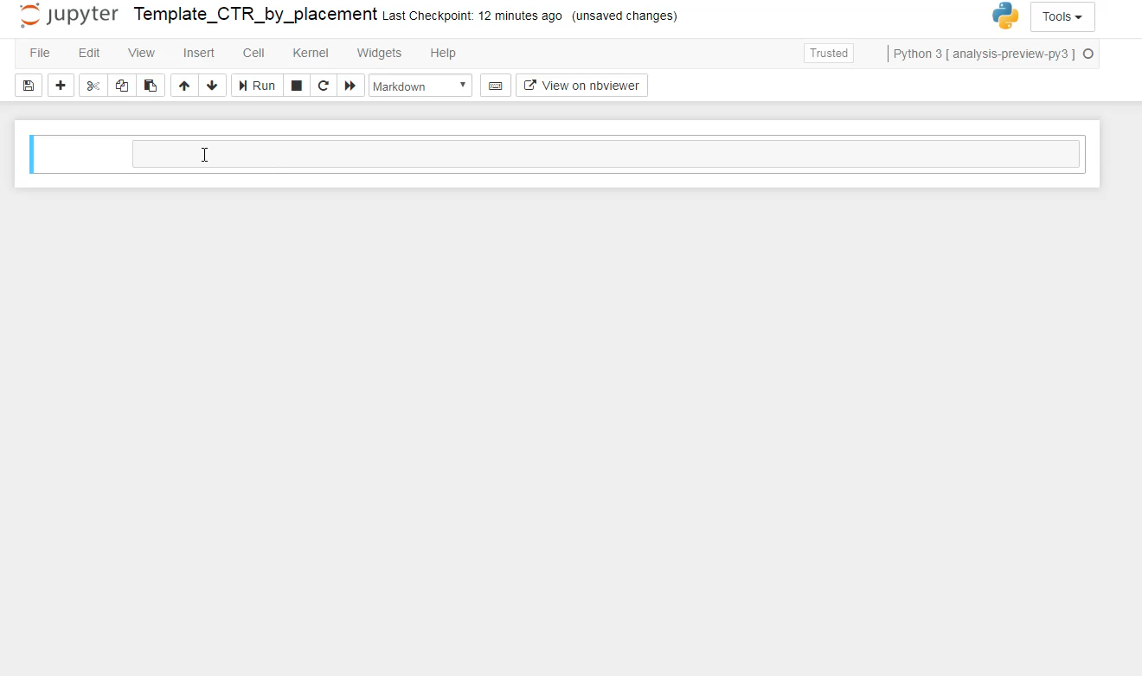
Creating a template
Notes:
We based our templates off of notebooks we currently used. You can also build from scratch. Using headers helps keep the layout organized. The markdown cells allow you to include important information/context to your template. Filling in sample inputs allows new users to try out code right away. We have an extension for collapsible headers which allows the user to focus in on the relevant code. Collapsing all the headers leaves you with a simple outline of the notebook.

Slide 12
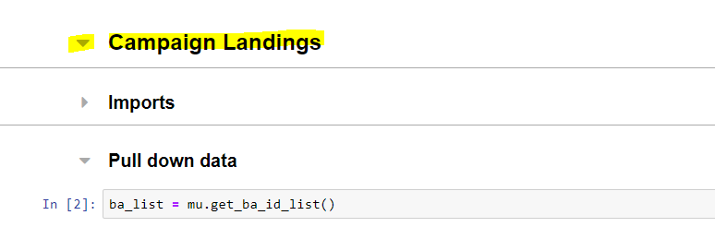
Setting Up a Template
Use Headers to group and label sections
Notes:
When building a notebook to use as a template using headers helps organize and maintain a logical workflow
Collapsible headers are a great extension!!

Slide 13
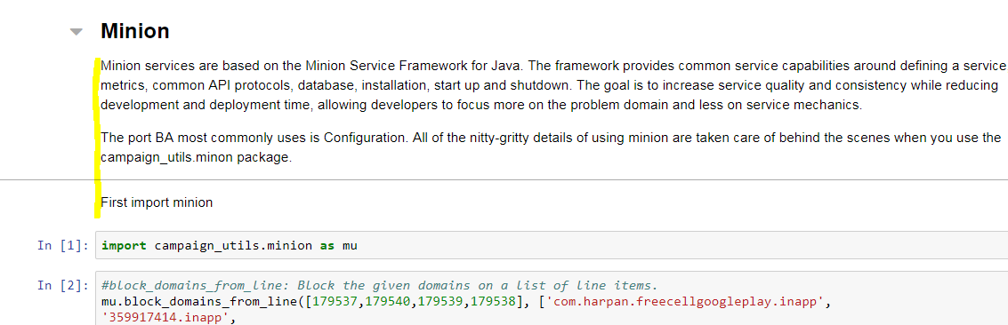
Setting Up a Template
Markdown cells for facts and explanations
Notes:
Especially helpful to add context, documentation, helper functions around code your team did not write

Slide 14
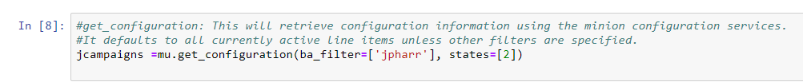
Setting Up a Template
Fill in sample inputs

Slide 15
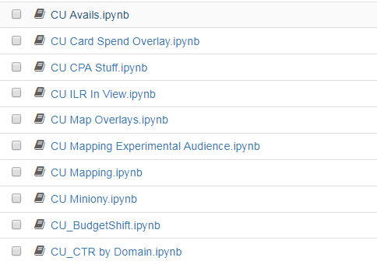
Benefits of Templates
Demonstrate frequently used functions and processes
Allow users to get acclimated to the Jupyter Environment

Slide 16
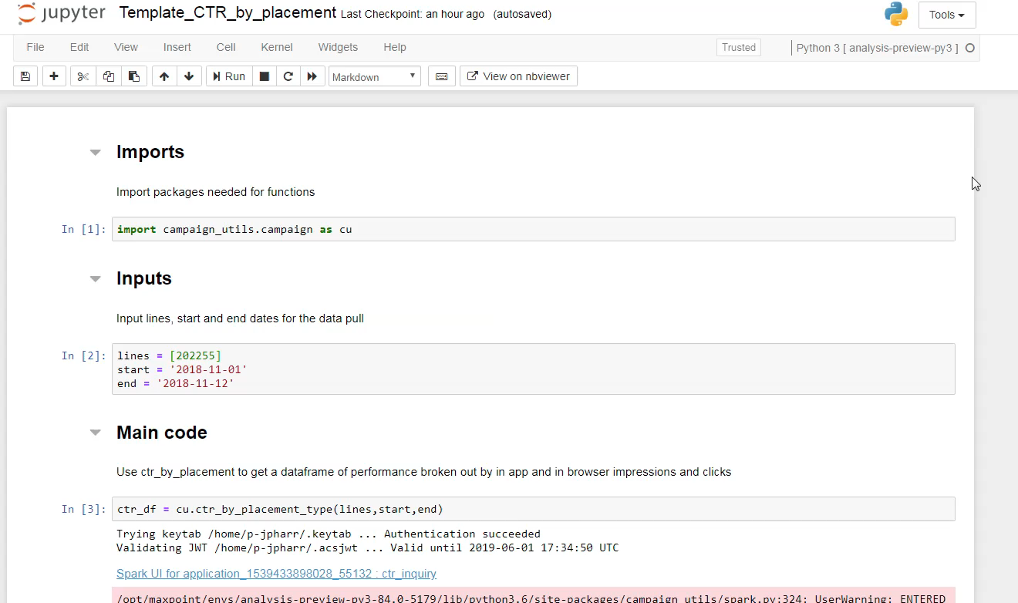
Ways to Share Template and Code

Slide 17
Training Templates
Used Notebook viewer links on internal training page
Included them in the training meeting invite
Changing the name or file path will break the link
Notes:
NB Viewer not common access

Slide 18
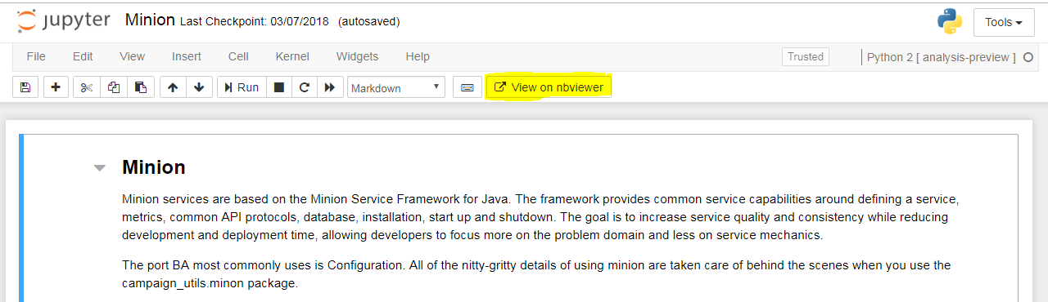
Sharing Code
Share using the Notebook Viewer link
Notes:
Sharing Errors/trouble shooting coding across team!

Slide 19
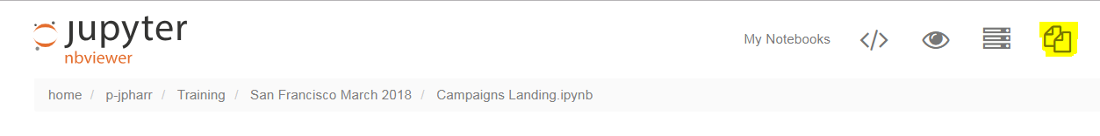
Sharing Code
Copy from Notebook Viewer

Slide 20
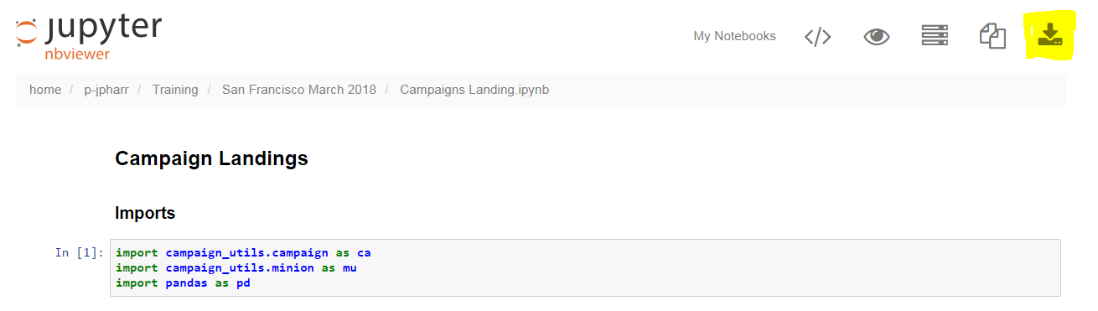
Sharing Code
Share via downloaded/saved .ipynb file

Slide 21
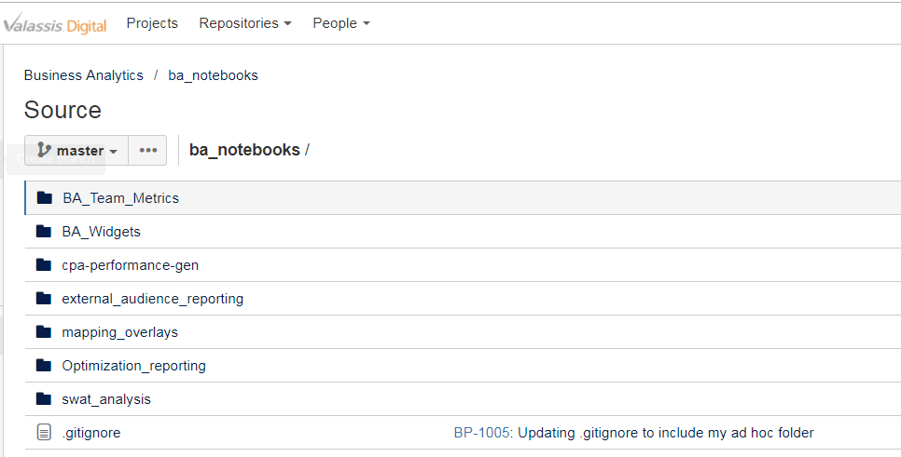
Sharing Code
Best for a collection of shared notebooks: git repo!

Slide 22
Repository
Git Repo

Slide 23
Guidelines for Repo documents
Most useful for infrequent asks
Not used often enough to formalize into a function
Complex tasks would take significant time to recreate
Reports that do not occur on a fixed schedule

Slide 24
Reasons to use a Repo
No more broken links
Consistency across the team—one master version
No more lost notebooks
Ease of finding latest version
Direct way to transfer corporate knowledge to new team members

Slide 25

Repo Example
Exposure file
Run Code
Improve Code
Exposure file
Branch & Pull Request
Notes:
Flow chart and images with the files animate visualization, representation of the workflow. Explain Exposure file example. 5 hours v. 90 minutes!

Slide 26
Testing Ground
Try out new techniques
Play with new packages
Quickly test new code

Slide 27
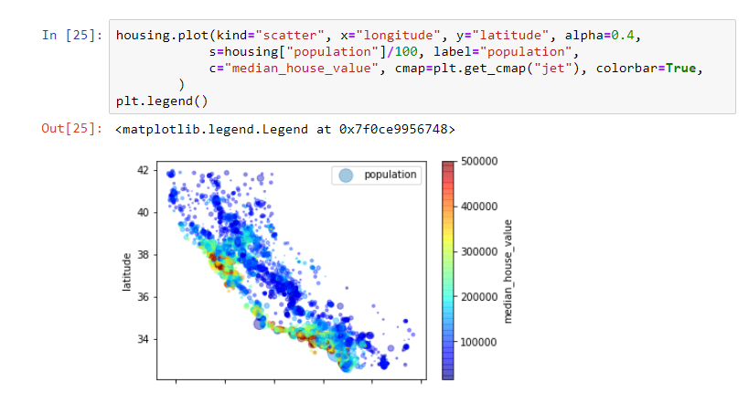
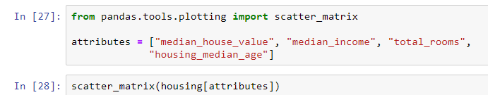
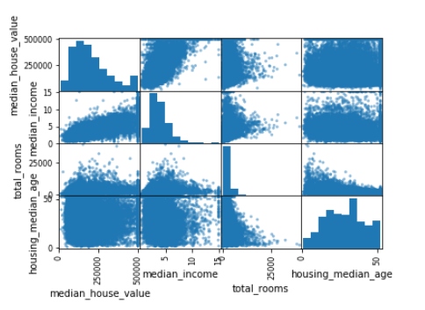
Testing Ground- Machine Learning
Matplotlib, pandas, sklearn

Slide 28
Recap
Use Notebooks to build templates
Extensions for collapsible headers, Notebook Viewer and copy are great!
Repositories are a great way to maintain and share infrequently used code
Notes:
Highlight corresponding advantage for trainee.

Slide 29
“I am always doing that which I cannot do, in order that I may learn how to do it.”
― Pablo Picasso

Slide 30
Questions?

Slide 31
Thank you!

